Slide 1

PRE-IDEATHON
GENESIS
IDEATHON
TEAM & DOMAIN
Team Name – Ryvex
Team Members – Rhaghavi S N, Charu Nethra C, Sai Durga C, Bhavya V
Selected Domain – Intelligent Systems & Digital Futures
Problem Statement – Secure Digital-Twin-Based Coordination of Industrial Waste Heat and Water Vapor Recovery with Dynamic AI Data-Center Cooling Demand

Slide 2


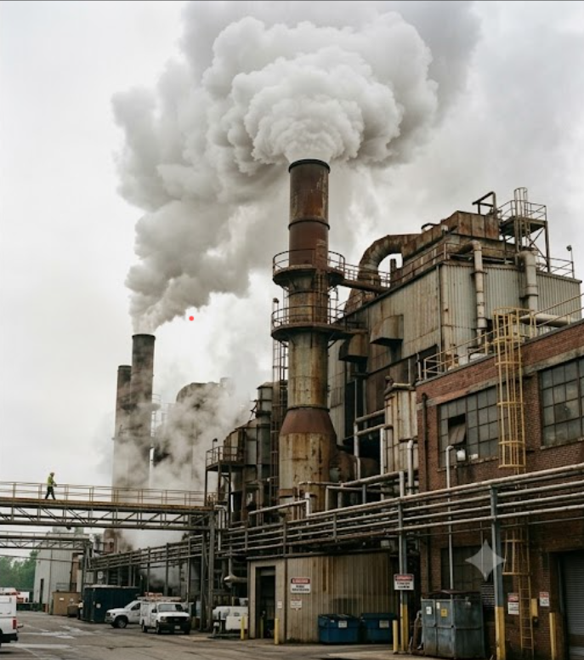

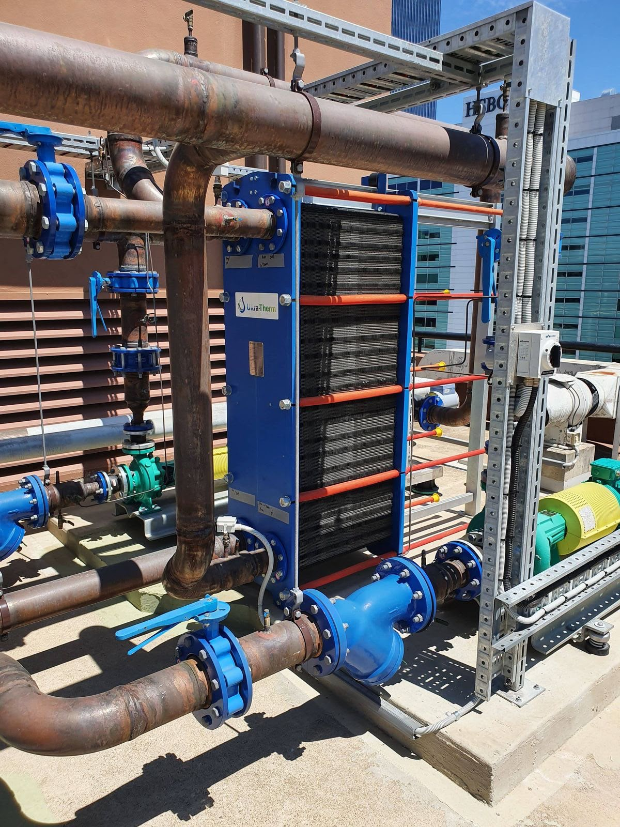
DOMAIN PROBLEM IN OUR WORDS
TEAM
Ryvex
What exactly needs to be solved?
Why is it important right now?
Data centres need continuous cooling and water for increasing computing needs.
The growth of AI and data centres is increasing cooling and water requirements
Industries generate usable waste heat and water vapour that can be recovered.
Industries need better ways to reuse heat, water and energy.
An AI system can monitor these resources in real time.
Recovering these resources can improve water and energy efficiency.
AI can predict resource availability and data-centre cooling demand.
AI and real-time data can make resource sharing adaptive and efficient.
Secure communication is needed to coordinate resources safely between industries and data centres.
Secure connectivity enables safe coordination between industrial facilities and data centres.

Slide 3



WHO IS AFFECTED?
TEAM
Ryvex
Target users, stakeholders and beneficiaries
Primary users
Secondary stakeholders
Who benefits if solved
Nearby Data Center Operators: Hyperscale and server farm managers looking to cut cooling costs and water usage.
Industrial Plant Managers:
Energy leaders in heat-heavy factories (textiles, paper, chemicals, cement) wanting to turn exhaust into revenue.
On-Site Cooling Engineers: Plant teams operating absorption chillers, water filters, and cooling towers
City Water Boards: Officials pushing to preserve drinking water and stop groundwater depletion.
Power Grid Companies (DISCOMs): Electricity providers wanting to ease heavy power demand during peak hours.
Environmental Regulators: Pollution control boards monitoring thermal waste and industrial emissions.
Equipment Partners: Companies supplying industrial heat recovery units and water filtration systems.
Local Cities & Communities: Save freshwater by reducing water loss and improving water reuse.
Industrial Plants: Earn new revenue by selling heat and steam instead of venting them as waste.
Data Centers: Cut monthly electricity and water bills while lowering their carbon footprint.
The Environment: Reduce energy waste, carbon emissions, and pressure on freshwater resources.

Slide 4
CURRENT SITUATION & CONTEXT
TEAM
Ryvex
Existing scenario, relevant facts and the workflow today
How it works today
415 → 945 TWh
20-50%
Plants vent hot exhaust and vapour through stacks and cooling towers.
1
Global data-centre electricity, 2024 to 2030 (IEA)
of industrial energy input is lost as waste heat (US DOE)
Data centres run chillers and evaporative towers on grid power and fresh water.
2
~150 bn L
>70%
The two sides share no data, forecast or contract.
3
water a year used by India's data centres (2024-25 est.)
of India's data-centre capacity sits in Mumbai and Chennai
Each pays for what the other throws away.
4

Slide 5
KEY CHALLENGES
TEAM
Ryvex
The Bottlenecks
Timing Gaps: Factory heat supply rises and falls with work shifts, while AI server cooling needs jump without warning.
The Root Causes
Industrial–IT Connectivity Barriers:Industrial control systems (OT) stay disconnected from IT systems to prevent cyberattacks.
The Business & Environmental Cost
Drinking Water Loss: Millions of liters of fresh city tap water evaporate in cooling towers daily.
Distance Limits: Heat degrades fast across long pipelines, requiring plants and data centers to be co-located.
Heat and Water Quality:Industrial exhaust may contain contaminants, and recovered water may require treatment before reuse.
Inflated Operating Bills: Data centers pay full price for electricity to run mechanical chillers.
Vented Energy: Reusable heat and clean moisture continue escaping into the atmosphere as waste.
Zero Shared Intelligence: Neither facility shares real-time schedules or demand forecasts.
No Trade Mechanism: No plug-and-play framework exists to price and exchange waste heat or recovered water
Main difficulties, root causes and consequences

Slide 6



EXISTING SOLUTIONS / APPROACHES
TEAM
Ryvex
What is already being done, and the gap it leaves
Existing Approach
Industrial Symbiosis: Neighboring industrial plants share steam and process water manually under static contracts (e.g., Kalundborg).
What It Does Today
Static Bulk Transfer: Offloads waste heat through fixed piping networks, governed by rigid multi-year agreements.
The Gap
Incapable of Dynamic AI Response: Zero real-time synchronization with sudden, second-by-second GPU compute workload bursts.
Internal Facility AI: Machine learning algorithms trim chiller power and fan speeds strictly inside the data center (e.g., DeepMind).
Standalone Hardware: Fixed absorption chillers and condensers installed without networked software intelligence
Inside-the-Fence Tuning: Lowers internal PUE by reacting only to thermal sensors placed on internal server racks.
Manual Mechanical Conversion: Thermally converts continuous heat streams to cold water at fixed design setpoints.
Ignores External Assets: Trapped inside facility walls—remains 100% dependent on expensive grid power and local city water.
No Cyber-Physical Brain: Lacks predictive forecasting, dynamic dispatch, and zero-trust security between industrial OT and IT.

Slide 7
PROBLEM INSIGHTS & OPPORTUNITY AREAS
TEAM
Ryvex
Resources required to solve the problem
Insight: hot exhaust can drive absorption chillers and its vapour can refill cooling towers, but only if supply, demand and security are coordinated.
Hardware
Software
Other resources
Temperature, humidity, flow and pressure sensors
Edge gateway at each site
Lab-scale heat exchanger rig (or simulated)
Workstation or cloud GPU for the twin
Python, physics models and ML forecasting
Optimiser (MILP or MPC)
MQTT / OPC UA and a time-series database
Dashboard, mTLS and role-based access
Mentor from a heat-intensive plant
Mentor from data-centre operations
Thermal and mechanical guidance
Public weather and plant datasets

Slide 8
INITIAL DIRECTION & EXPECTED OUTCOME
TEAM
Ryvex
What we plan to do, and how it should work
What we plan to do
What we want to improve
Initial simulation targets
Build a simulated twin of one plant and one data centre
Forecast heat, vapour and cooling load
Suggest an hourly plan within safe limits
Chiller electricity and fresh water use
How much vented heat and vapour actually gets used
Water top-up down 20-30%
Cooling electricity down 10-15%
Forecast error under 10%
All against a chiller-only baseline
Hot exhaust or hot water from the plant
Absorption chiller makes chilled water
Chilled water goes to the data centre
Twin and forecast
Predicts heat, vapour and cooling load, then suggests a plan. It only advises; people or the plant’s own controls act.
Water vapour in the exhaust
Condense, treat, check quality
Tops up the cooling tower only if it passes
Safety rule: normal chillers and mains water stay on as backup, and the plan can never override equipment limits.
8

